Slide 1

Hydrological Modelling in India
A. K. Gosain
Professor, Civil Engineering Department
Indian Institute of Technology Delhi

Slide 2
Water Resources Development
Water resource is finite (with natural variability)
Any development big or small involves in moving the water around (more often upstream)
Every development/intervention has associated impact

Slide 3
Issues around Water Resources Development
Many parallel programs with competing demands
  Such as watershed management, rainwater harvesting, urban & industrial development, etc.
Ignoring environmental demand
No mechanism for tradeoffs between competing demands

Slide 4
Sustainability – Major concern
This brings us to the question of sustainability
  Which is about maintaining the hydrological and environmental health of the drainage system
IWRM philosophy has been the scientific option available but seldom used
  Basin being the natural system where water balance can be resolved and thereby impacts of the manmade interferences quantified

Slide 5
Actions required to be taken
Develop Integrtaed River Basin Management Plans
  Resource availability (temporal & spatial)
  Present & future demand
  Efficiencies of projects
  Environmental status
  Developmental pathways (with & without Climate Change)
  Information formulation & sharing

Slide 6
Scientific base is essential
All the above actions require specific models to be deployed
  Hydrological model
  Groundwater model
  Hydraulic model
  Water quality model
  Environment model
  System model
  Frameworks to allow interoperability

Slide 7
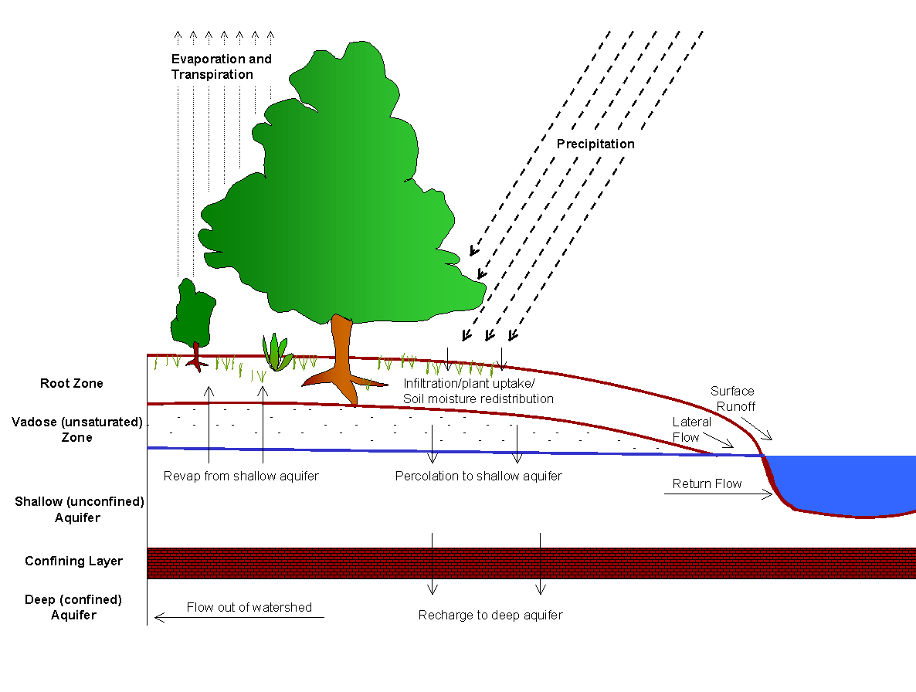
Hydrological Model Components
Desired Features
Physically based
Distributed model
Continuous time model (long term yield model)
Use readily available data

Slide 8
Some of the major hydrological studies performed at IIT Delhi
India’s National Communications (NATCOM) to UNFCCC Coordinated by MoEF (2004 and 2012)
  Climate change impacts on water Resources was entrusted to IIT Delhi
Ganga River Basin Management Plan of IIT Consortium
  Hydrological and Groundwater modelling
  Team Leader of WRM Group

Slide 9
River Basins Modeled – NATCOM II
    http://gisserver.civil.iitd.ac.in/natcom/

Slide 10
Modelling Outcomes
Detailed outputs include all the water balance component at spatial and temporal scales which are analysed for
  Changes in magnitude and frequency of flood peaks
  Severity of droughts
  Changes in flow patterns
  Changes in groundwater recharge

Slide 11
Change in precipitation towards 2030s and 2080s

Slide 12
Change in Water Yield towards 2030s and 2080s

Slide 13
Change in Evapo-transpiration towards 2030s and 2080s

Slide 14
Change in Sediment Yield towards 2030s and 2080s

Slide 15
Change in monsoon drought weeks towards 2030s & 2080s

Slide 17
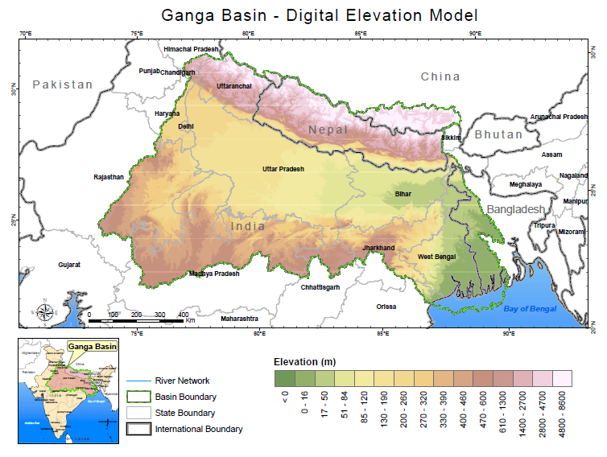
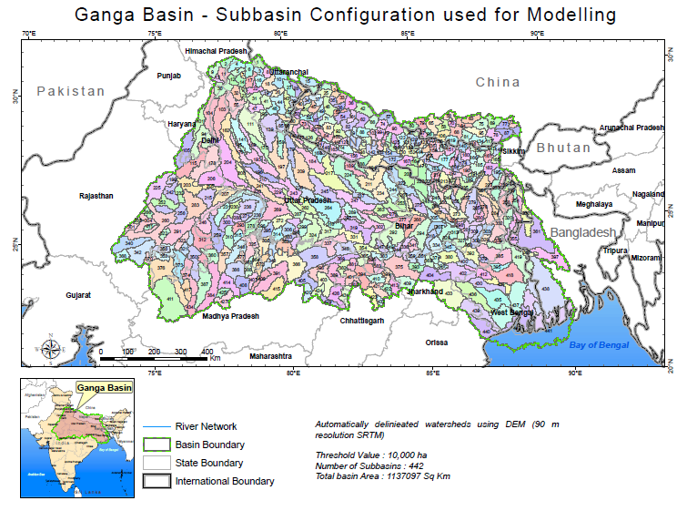
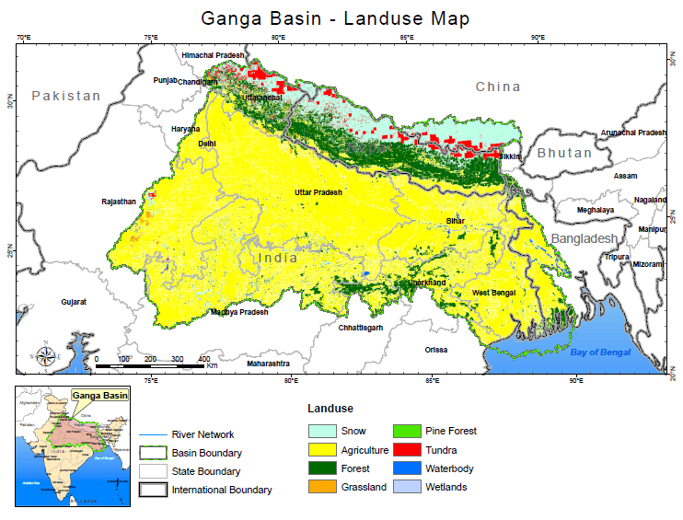
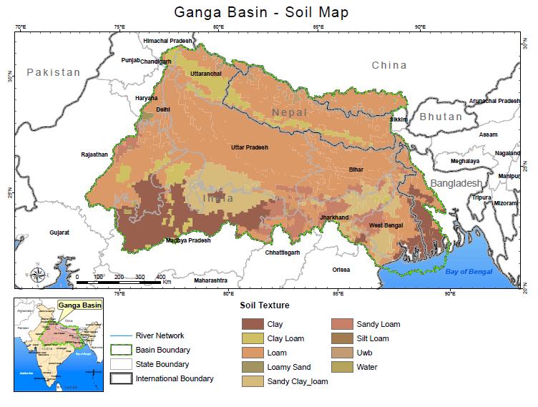
Ganga Basin Hydrological Modelling – Base layers

Slide 18
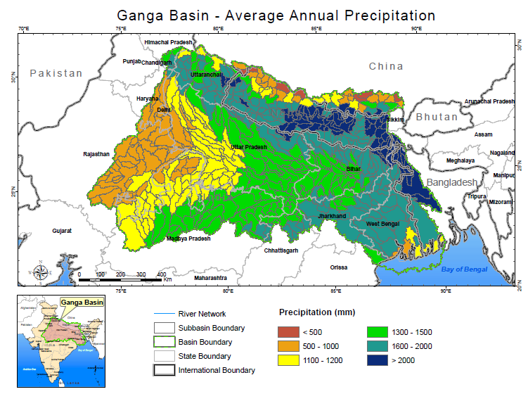
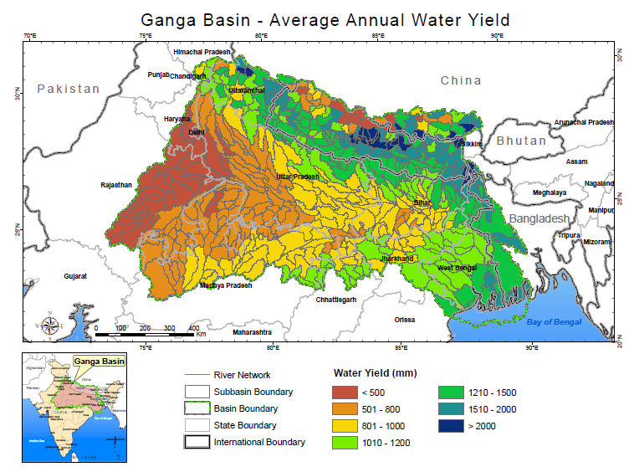
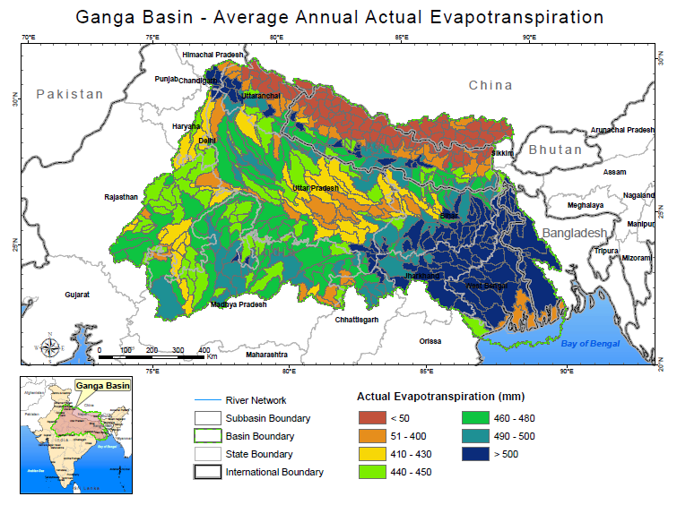
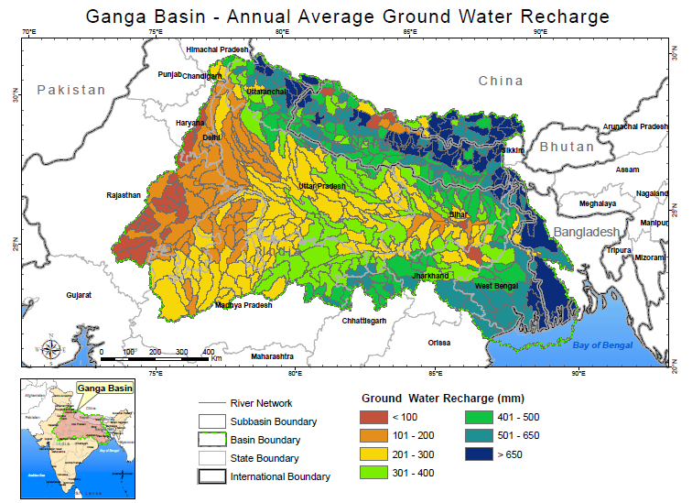
Ganga Basin Hydrological Modelling – SWAT Outputs

Slide 19
Depth to Water Table for Present and Virgin Case

Slide 20
Surface & Groundwater Interaction for Present and Virgin

Slide 21
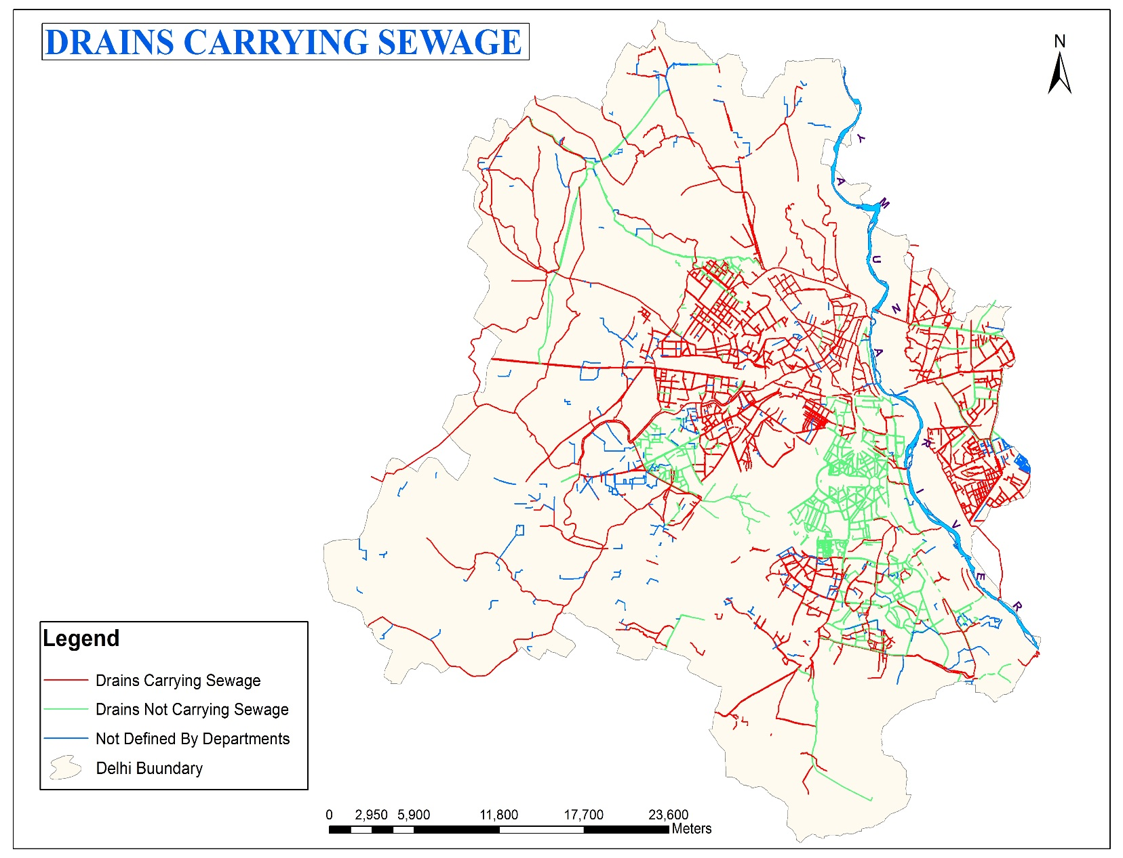
Drainge Master Plan Delhi-Fate of Natural and Artificial Storm Drains
Most of the drains (all shown in red) in Delhi Carry Sewage throughout the year
Storm drains are supposed to run only during the monsoon
Many of them are getting encroached and disappearing

Slide 22
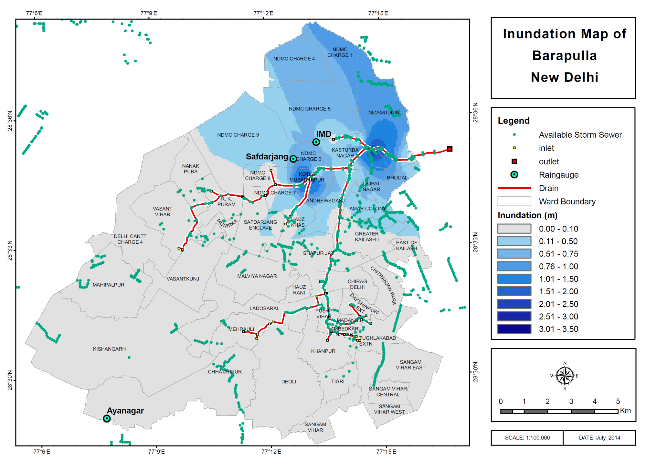
Inundation Mapping using Natural Drains- Barapulla

Slide 23
The Major Requirement
To we keep pace with the fast changing baseline
A common framework is required to provide an integrated information base
Procedures/Tools for monitoring scenario generation and evaluation

Slide 24
Recent Initiative by IIT Delhi
  MoU signed between eWater of Australia & IIT Delhi
  IITD identified Centre of Excellence for eWater
  Engage in capacity building with a difference
Identified in collaboration with CWC four basins to initiate Basin Plans
  Narmada Basin
  Palar Basin
  Mahi Basin
  Yamuna Basin upto Etawah

Slide 25
Conclusions
Integrated River Basin Management plans are required to be formulated
Creation of sharable information is essential for sustainable use of water resources through engagement of stakeholders
For the purpose one of the essential requirement is capacity building of all the organizations engaged in the process

Slide 26
Thank you

